Slide 1
Creating a Employee performance scorecard
Student name: S. Jagadeshwaran
Department: Bcom(G) ‘a’
Register no: 312211621
College: Thiruthangal Nadar College

Slide 2
Employee performance scorecard using excel

Slide 3
Problem statement :-
Identify the challenges your organization faces in evaluating employee performance, such as:
Inconsistent assessments
Lack of transparency
Insufficient data
Inefficient processes

Slide 4
Project Overview :-
Describe the purpose and objectives of the employee performance scorecard project, including:
Developing a standardized evaluation framework
Improving performance measurementaccuracy
Enhancing employee growth and development

Slide 5
End Users :-
Define the stakeholders who will utilize the scorecard, such as:
Employees
Managers
HR professionals
Department heads

Slide 6
Our Solution and Proposition
Explain the benefits and unique value proposition of your employee performance scorecard, including:
Data-driven insights
Fair and transparent evaluations
Personalized development plans
Enhanced employee engagement

Slide 7
Data Description :-
Outline the data sources and metrics that will be used to evaluate employee performance, such as:
Job-specific KPIs
Competency assessments
Feedback from managers and peers
Training and development records
C

Slide 8
Modelling Approach
Describe the methodology and tools used to develop the scorecard, including:
Statistical models for performance prediction
Weighted scoring ssystems
Data visualization techniques

Slide 9
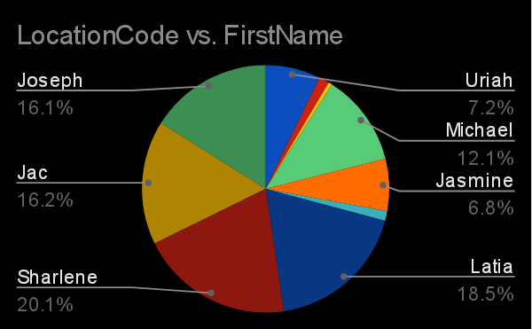
Pie chart :-

Slide 10
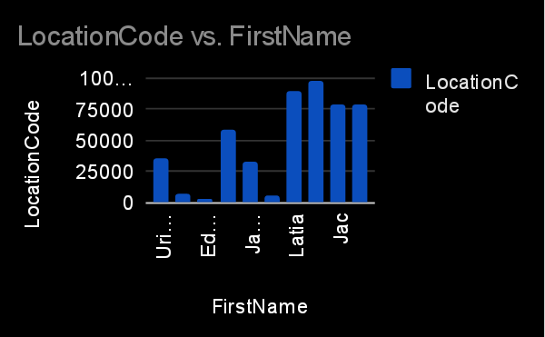
Bar Diagram :-

Slide 11
Conclusion
Summarize the key findings and benefits of the employee performance scorecard, and outline future plans for refinement and expansion.
This expanded outline should provide a comprehensive structure for your employee performance scorecard project.

Slide 12
THANK YOU

